Slide 1

Data Analytics Framework for A Game-based Rehabilitation System
Jiongqian (Albert) Liang*, David Fuhry*, David Maung*, Alexandra Borstad⁺, Roger Crawfis*, Lynne Gauthier⁺, Arnab Nandi*, Srinivasan Parthasarathy*
* Department of Computer Science and Engineering.
⁺ Wexner Medical Center.
The Ohio State University

Slide 2
Outline
Motivation
Introduction
Data Analysis Framework
Experiments
Conclusion

Slide 3
Motivation
Stroke happens when blood flow to an area of the brain stops.
Around 4 million stroke patients in the US.
It costs the US more than $34 billion annually.

Slide 4
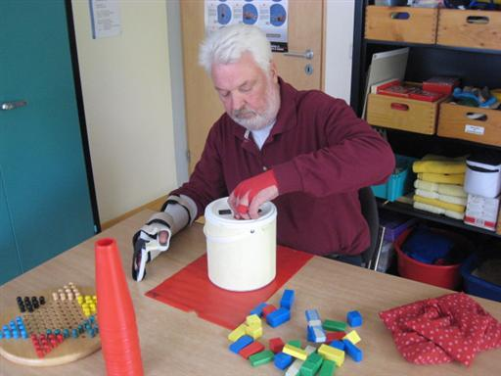
Motivation

Slide 5
Motivation
Getting physical therapy is difficult.
Fewer than 1% receive it (in the US):
Too costly
Travelling difficulties for stroke patients
Not enough providers

Slide 6
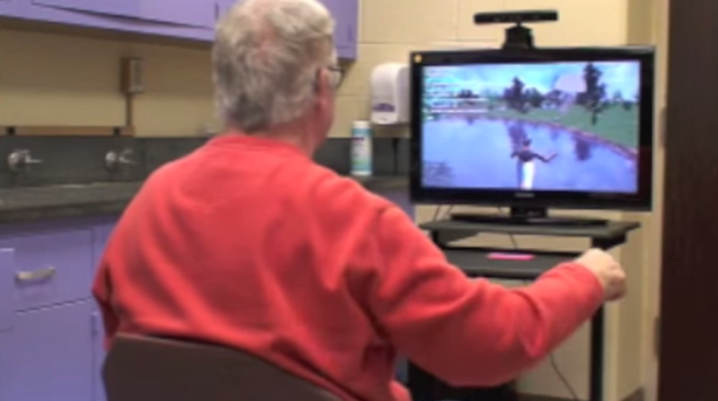
Motivation

Slide 7
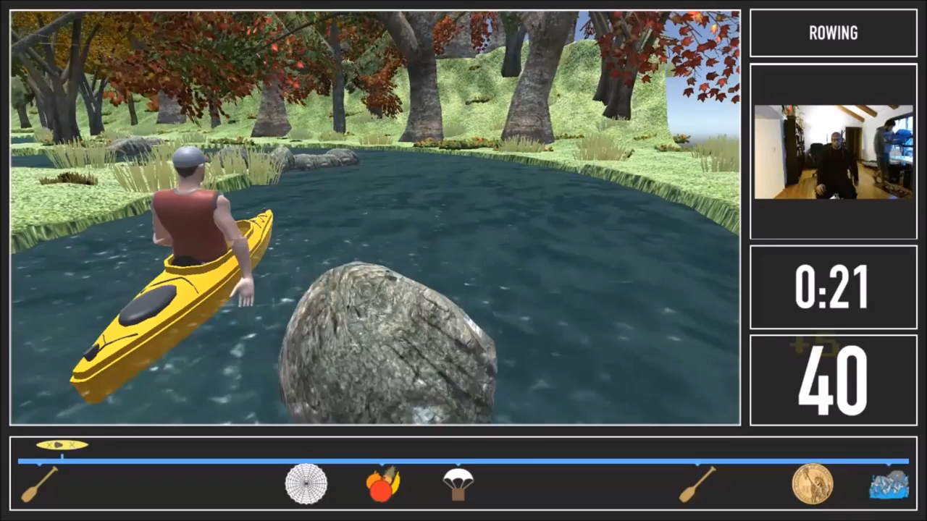
Motivation
See full video at https://youtu.be/G5MyBNvNEfg

Slide 8
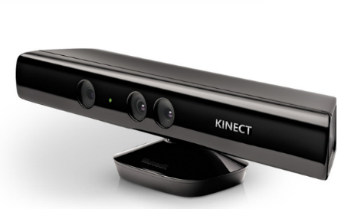

Introduction
Patients play the game in front of Kinect.
Skeleton Data
Kinect-based Rehabilitation Game
Game Log
Kinect collects skeleton data. Software recognizes gesture (game log).
Data Analytics Framework
Evaluation of the rehabilitation & Feedback
Data analytics for performance evaluation.

Slide 9
Introduction
In this work, we
Propose a data analytics framework to evaluate the efficacy of the rehabilitation.
Show some preliminary results based on some participants we recruited.
Show our evaluation based on game data is consistent with a standard test in the lab.

Slide 10
Data Analytics framework
Data Preprocessing
Rehabilitation Analysis
Temporal smoothing
Hand Speed
Anomaly filtering
Angle Speed
Range of Motion
Contextual Filtering
Trend Analysis
Gesture Segmentation
Region Segmentation

Slide 11
Data Preprocessing
Data Preprocessing
Rehabilitation Analysis
Contextual Filtering
1. Temporal smoothing:
Problem: limited sensor spatial resolution, but 30 snapshots each sec. Movement might be due to “jitter” and sensor limitations.
Solution: set a sliding time window T (200 ms), and average snapshots.

Slide 12
Data Preprocessing
Data Preprocessing
Rehabilitation Analysis
Contextual Filtering
2. Anomaly filtering:
Problem: there are some erroneous snapshots.
Solution: Inside a time window, remove snapshot if the distance of it to the averaged snapshot > µ+3𝞂.

Slide 13
Contextual Filtering
Data Preprocessing
Rehabilitation Analysis
Contextual Filtering
Gesture Segmentation:
Reason: there are different gestures. Analyze patients’ movement during each gesture period (dynamically).
Solution: concatenate continuous snapshots of the same gesture with temporal gaps smaller than 2,000 ms (using game log).

Slide 14
Contextual Filtering
Data Preprocessing
Rehabilitation Analysis
Contextual Filtering
Region Segmentation:
Reason: the game contains several different regions with different difficulties and intensities.
Self-paced movement: e.g., Rowing.
Fast-paced movement: e.g., Rapids.
Solution: refer to the game log, synchronize the timestamp and segment out skeleton data.

Slide 15
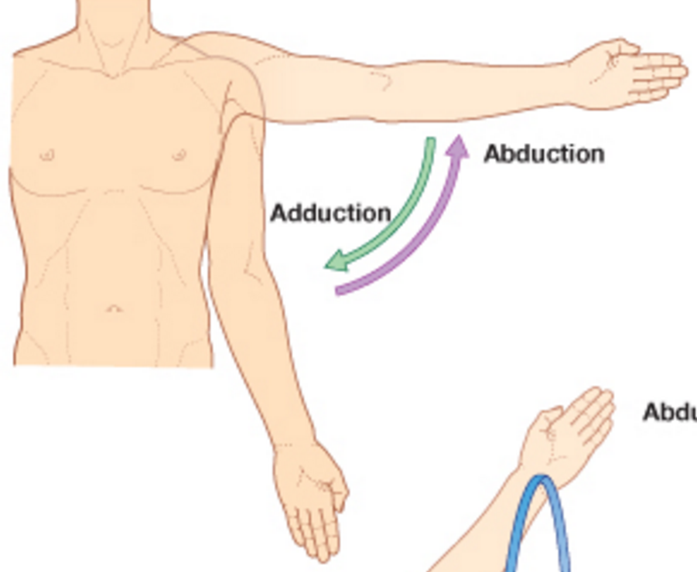
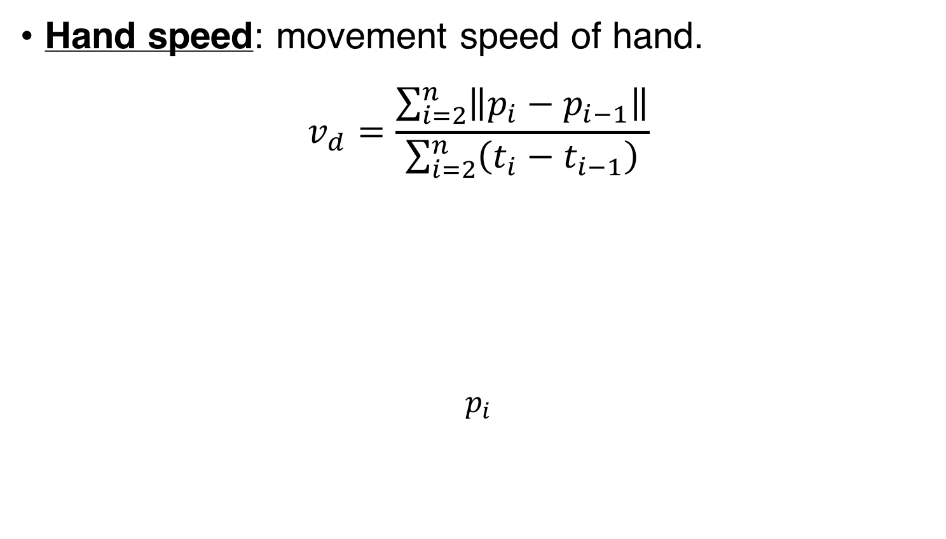
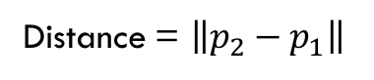
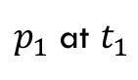
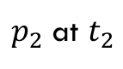
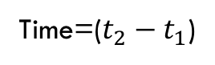
Rehabilitation analysis
Data Preprocessing
Rehabilitation Analysis
Contextual Filtering
Hand speed: movement speed of hand.
$$v_{d}=\frac{\sum_{i=2}^{n}{\left\|p_{i}−p_{i−1}\right\|}}{\sum_{i=2}^{n}{\left(t_{i}−t_{i−1}\right)}}$$
$$p_{i}$$
$p_{2}$ at $t_{2}$
dis
Distance = $\left\|p_{2}−p_{1}\right\|$
Time=($t_{2}−t_{1}$)
$p_{1}$ at $t_{1}$

Slide 16
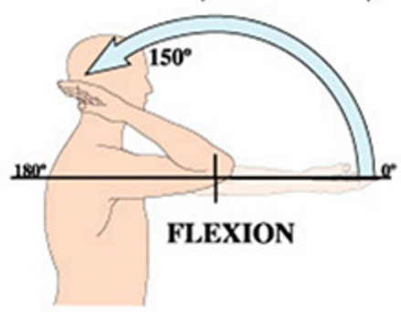
Rehabilitation analysis
Data Preprocessing
Rehabilitation Analysis
Contextual Filtering
Angle speed: similar to movement speed, but on angle.
Angle distance.

Slide 17
Rehabilitation analysis
Data Preprocessing
Rehabilitation Analysis
Contextual Filtering
Range of Motion: difference between min and max angles of a body joint. It measures the active range.
max
min

Slide 18
Experiment Analysis
8 participants were recruited (at least 3 months post-stroke)
Participant ID | Affected Side | Days | Total Mins | Avg mins/day
P1 | Left | 21 | 678.6 | 32.3
P2 | Right | 14 | 803.2 | 57.4
P3 | Left | 19 | 656 | 34.5
P4 | Right | 21 | 978.5 | 46.6
P5 | Right | 20 | 2185.5 | 109.3
P6 | Right | 21 | 2084.3 | 99.3
P7 | Right | 20 | 1351.4 | 67.6
P8 | Right | 13 | 881.6 | 67.8

Slide 19
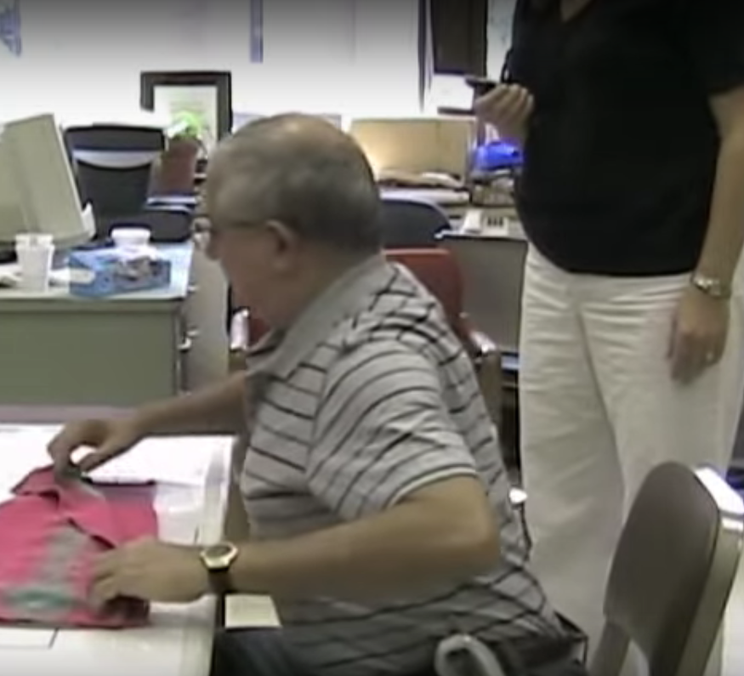
Experiment Analysis
Pre/post comparison: before and after the participants used the rehab system, they conduct Wolf Motor Function Test (WMFT).
The test measures the time to perform 15 standardized motor tasks.
Examples: lifting pencil and placing the hand on top of a box.
Calculate the rate based on the time.

Slide 20
Experiment Analysis: three parts
Two-half Comparison
Region Segment
Trend Analysis

Slide 21
Two-half Comparison
Experiment Analysis
Region Segment
Trend Analysis
Two-half comparison approach:
Divided the whole rehabilitation period into two halves.
Calculate the kinematic variables in these two divisions respectively (hand speed, angle speed, etc.).
Compare the averaged values of two halves.
Conduct t-test to see the significance of difference.
Compare with WMFT result.

Slide 22
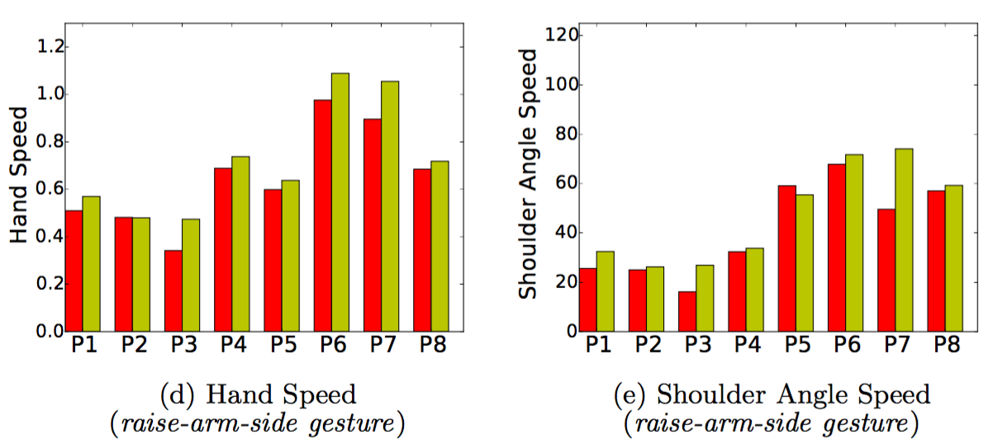
Two-half Comparison
Experiment Analysis
Region Segment
Trend Analysis
Observation 1: Improvements over the two halves.

Slide 23
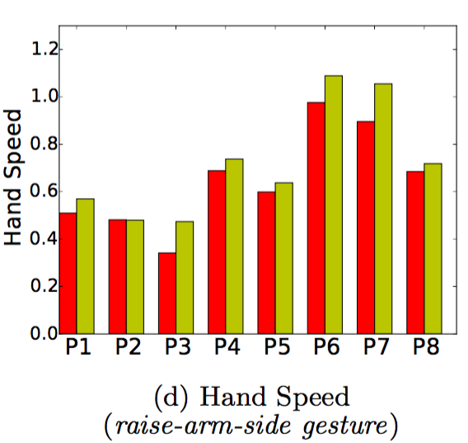
Two-half Comparison
Experiment Analysis
Region Segment
Trend Analysis
Observation 2: consistency. Trend & Scale.
Wolf Motor Function Test result

Slide 24
Two-half Comparison
Experiment Analysis
Region Segment
Trend Analysis
Two-half comparison & Wolf Motor Function Test:
Very different metrics (game data analysis vs. lab test).
Show very consistent pattern of performance.
Kinematic measurement based on game data can serve as complimentary assessment (cheaper, more convenient).

Slide 25
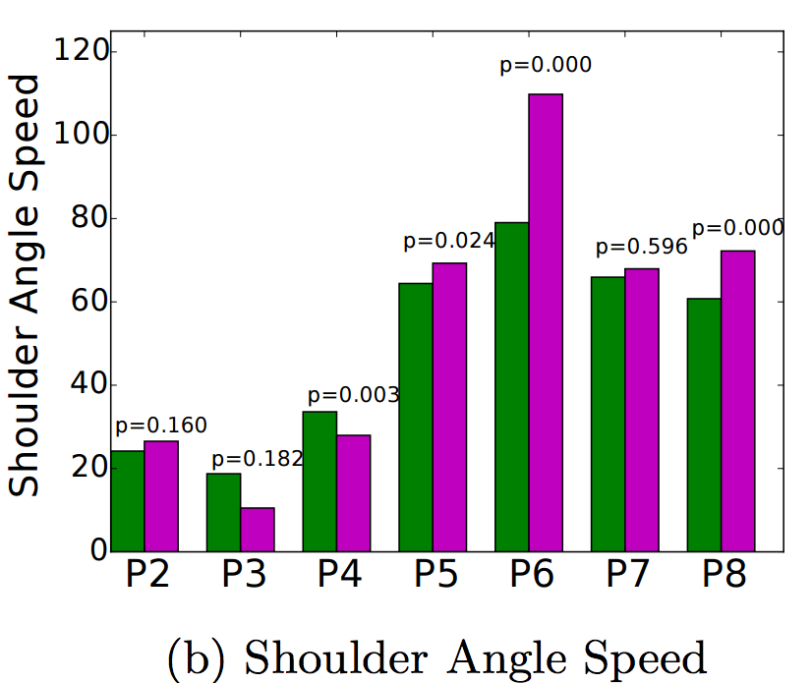
Two-half Comparison
Experiment Analysis
Region Segment
Trend Analysis
Self-paced (Rowing Region) vs. fast-paced (Rapids Region) *.
?
* P1 did not have different
regions during gameplay.

Slide 26
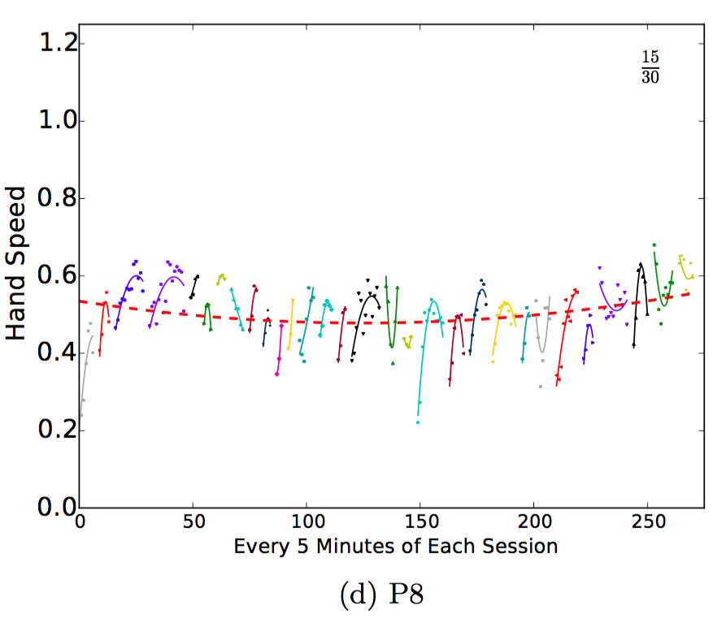
Two-half Comparison
Experiment Analysis
Region Segment
Inverted “U”: sign of fatigue.
Trend Analysis
Conduct a fine-grained trend analysis:
Segment the game data by game session.
Compute the average hand speed every five minutes each session.

Slide 27
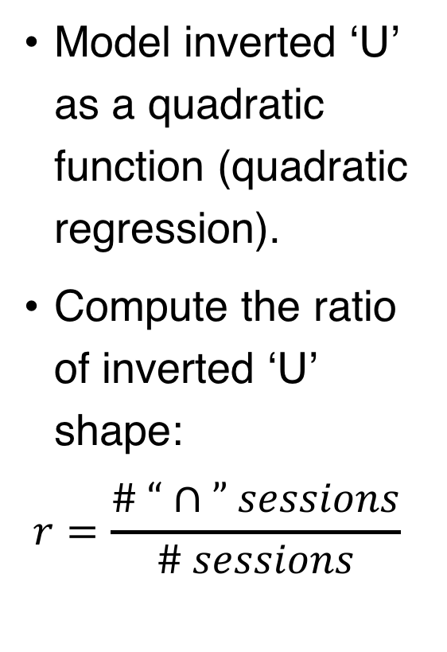
Two-half Comparison
Experiment Analysis
Region Segment
Trend Analysis
Model inverted ‘U’ as a quadratic function (quadratic regression).
Compute the ratio of inverted ‘U’ shape:
$$r=\frac{\# “∩” sessions}{\# sessions}$$

Slide 28
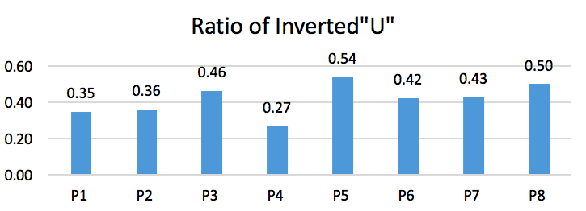
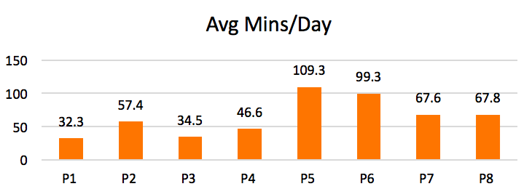
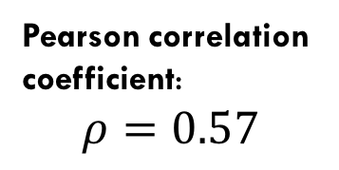
Two-half Comparison
More gameplay time ➔ More inverted “U”
Region Segment
Trend Analysis
Pearson correlation
coefficient:
$$ρ=0.57$$
<

Slide 29
Conclusion
Propose a data analytics framework to evaluate game-based rehab.
Patients have obvious improvement but in different aspects. Consistent with standard WMFT in the lab.
Reveal sign of fatigue, correlated with the gameplay time.

Slide 30
Questions?
Acknowledgements:
PCORI, UL1TR001070, NSF-EAR-1520870 and NSF-DMS-1418265.

